Slide 1

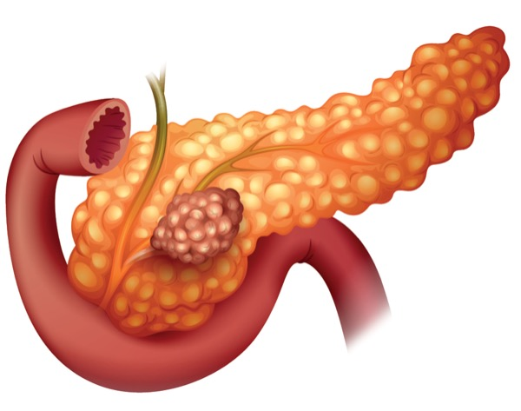
Surveillance for Pancreatic Ductal Adenocarcinoma in CDKN2A/p16 Mutation Carriers
Derk Klatte
Research Meeting Clinical Epidemiology
D.C.F.Klatte@lumc.nl

Slide 2

Outline
Surveillance for pancreatic cancer:
Why and how?
Outcomes of surveillance in CDKN2A mutation carriers
Comparison of pancreatic cancer outcomes with general population
Notes:
Incidence is increasing; expected to be the 2nd cause of cancer related mortality in 2030

Slide 3
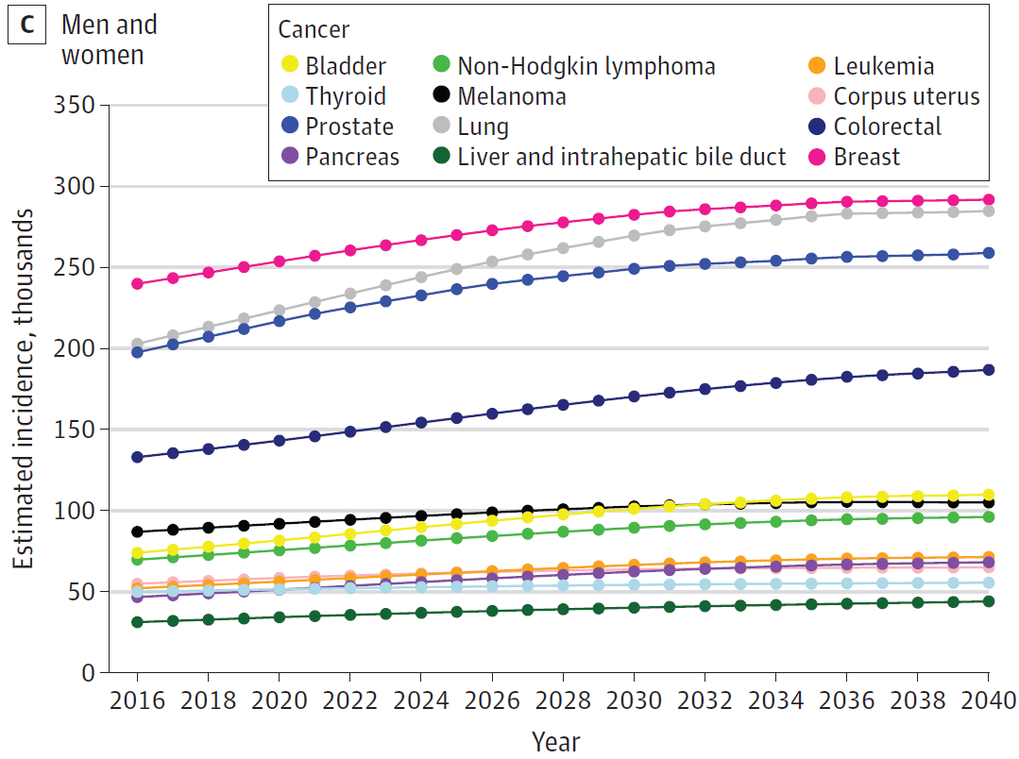
Growing burden of pancreatic cancer
Soon 2nd leading cause of cancer-related mortality
Relatively rare malignancy
Incidence slowly increasing
Rahib L, Wehner MR, Matrisian LM, Nead KT. Estimated Projection of US Cancer Incidence and Death to 2040. JAMA Netw Open. 2021;4(4):e214708. doi:10.1001/jamanetworkopen.2021.4708
Notes:
Incidence is increasing; expected to be the 2nd cause of cancer related mortality in 2030

Slide 4
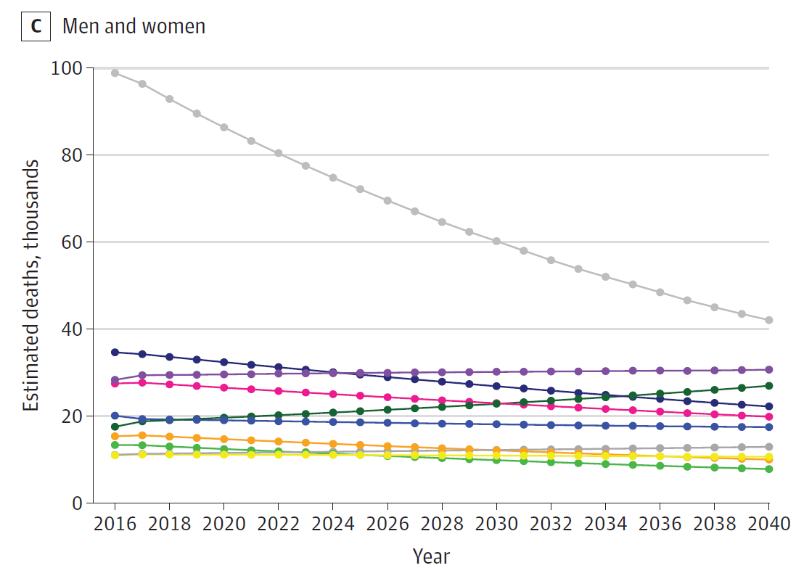
Growing burden of pancreatic cancer
Soon 2nd leading cause of cancer-related mortality
Relatively rare malignancy
Incidence slowly increasing
Survival barely improving
5-year survival rate: 5-10%
Lung
CRC
PC
Rahib L, Wehner MR, Matrisian LM, Nead KT. Estimated Projection of US Cancer Incidence and Death to 2040. JAMA Netw Open. 2021;4(4):e214708. doi:10.1001/jamanetworkopen.2021.4708
Notes:
Incidence is increasing; expected to be the 2nd cause of cancer related mortality in 2030

Slide 5
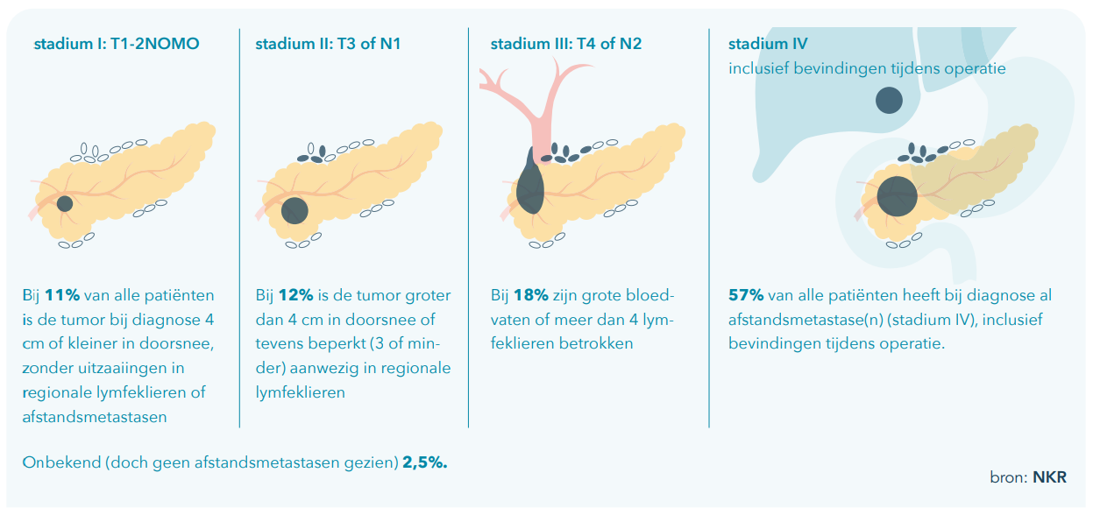
Only 11% stage I at diagnosis

Slide 6
Early detection essential to improve prognosis
5-year survival rate by stage
Localized disease 42%
Regional disease 14%
Metastatic disease 3%

Slide 7
Screening of general population
Life-time risk for PDAC 1.7%
Screen 100,000 asymptomatic individuals
Age-adjusted incidence rate 13 per 100,000 men and women per year*
Screening test with 100% sensitivity and 99% specificity
Detect all 13 PC cases
~1000 false positive results
Not feasible
*Wu W, He X, Yang L, et al. Rising trends in pancreatic cancer incidence and mortality in 2000-2014. Clin Epidemiol. 2018;10:789-797. Published 2018 Jul 9. doi:10.2147/CLEP.S160018

Slide 8
Screen enriched population
Life-time risk PDAC 3-fold: 5.1% (>5% = “cutoff”)
Screen 100,000 asymptomatic individuals
Age-adjusted incidence rate 39 per 100,000 men and women per year*
Screening test with 100% sensitivity and 99% specificity
Detect all 39 PC cases
~1000 false positive results
Feasible?
*Wu W, He X, Yang L, et al. Rising trends in pancreatic cancer incidence and mortality in 2000-2014. Clin Epidemiol. 2018;10:789-797. Published 2018 Jul 9. doi:10.2147/CLEP.S160018

Slide 9
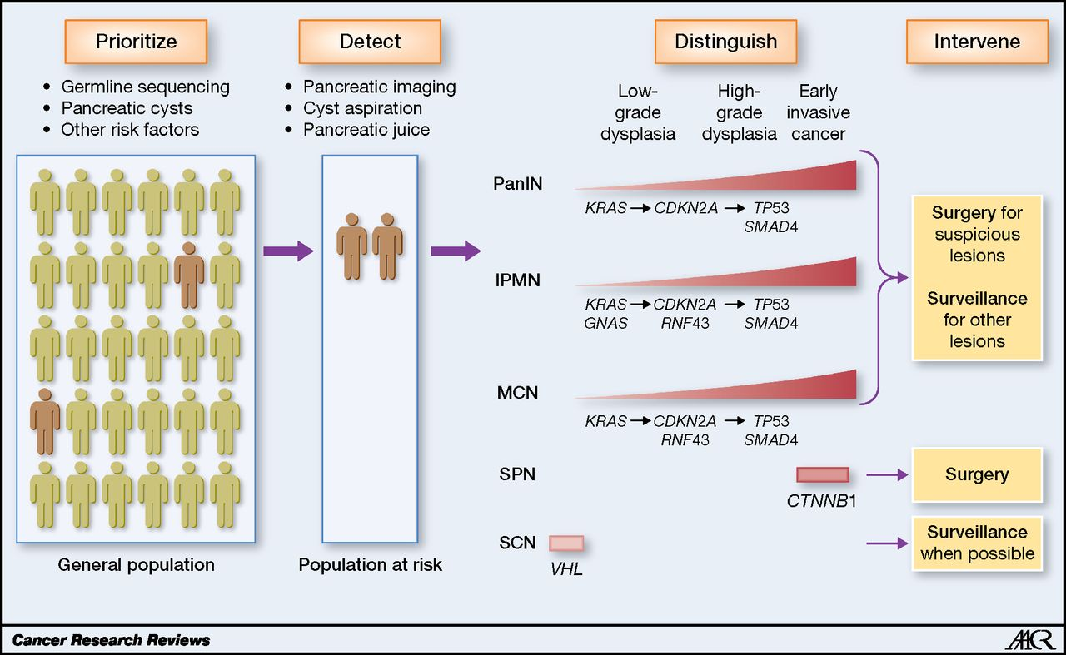
Surveillance for high-risk individuals framework for early detection
Screening
Goal:
high-grade precursors or
T1N0M0 PDAC

Slide 10
Who, when and how? Summary of the caps consortium guideline
Who should be offered surveillance?
Regardless of family history: CDKN2A (hereditary melanoma) and Peutz-Jeghers syndrome
BRCA1/2, PALB2 (HBOC); ATM; MLH1/MSH2/MSH6 (Lynch syndrome) + 1 FDR
Familial*
When?
How?
Goggins M, Overbeek KA, Brand R, et al. International Cancer of the Pancreas Screening (CAPS) consortium. Management of patients with increased risk for familial pancreatic cancer: updated recommendations from the International Cancer of the Pancreas Screening (CAPS) Consortium. Gut. 2020 Jan;69(1):7-17.
Notes:
Incidence is increasing; expected to be the 2nd cause of cancer related mortality in 2030

Slide 11
Who, when and how? Summary of the caps consortium guideline
Who should be offered surveillance?
Regardless of family history: CDKN2A (hereditary melanoma) and Peutz-Jeghers syndrome
BRCA1/2, PALB2 (HBOC); ATM; MLH1/MSH2/MSH6 (Lynch syndrome) + 1 FDR
Familial*
When? CDKN2A and Peutz-Jeghers at age 40; others 45+ years
How?
Goggins M, Overbeek KA, Brand R, et al. International Cancer of the Pancreas Screening (CAPS) consortium. Management of patients with increased risk for familial pancreatic cancer: updated recommendations from the International Cancer of the Pancreas Screening (CAPS) Consortium. Gut. 2020 Jan;69(1):7-17.
Notes:
Incidence is increasing; expected to be the 2nd cause of cancer related mortality in 2030

Slide 12
Who, when and how? Summary of the caps consortium guideline
Who should be offered surveillance?
Regardless of family history: CDKN2A (hereditary melanoma) and Peutz-Jeghers syndrome
BRCA1/2, PALB2 (HBOC); ATM; MLH1/MSH2/MSH6 (Lynch syndrome) + 1 FDR
Familial*
When? CDKN2A and Peutz-Jeghers at age 40; others 45+ years
How? Alternate MRI/MRCP and EUS
Every 12 months if no abnormalities
3-6 months for abnormalities not requiring immediate surgery
Goggins M, Overbeek KA, Brand R, et al. International Cancer of the Pancreas Screening (CAPS) consortium. Management of patients with increased risk for familial pancreatic cancer: updated recommendations from the International Cancer of the Pancreas Screening (CAPS) Consortium. Gut. 2020 Jan;69(1):7-17.
Notes:
Incidence is increasing; expected to be the 2nd cause of cancer related mortality in 2030

Slide 13

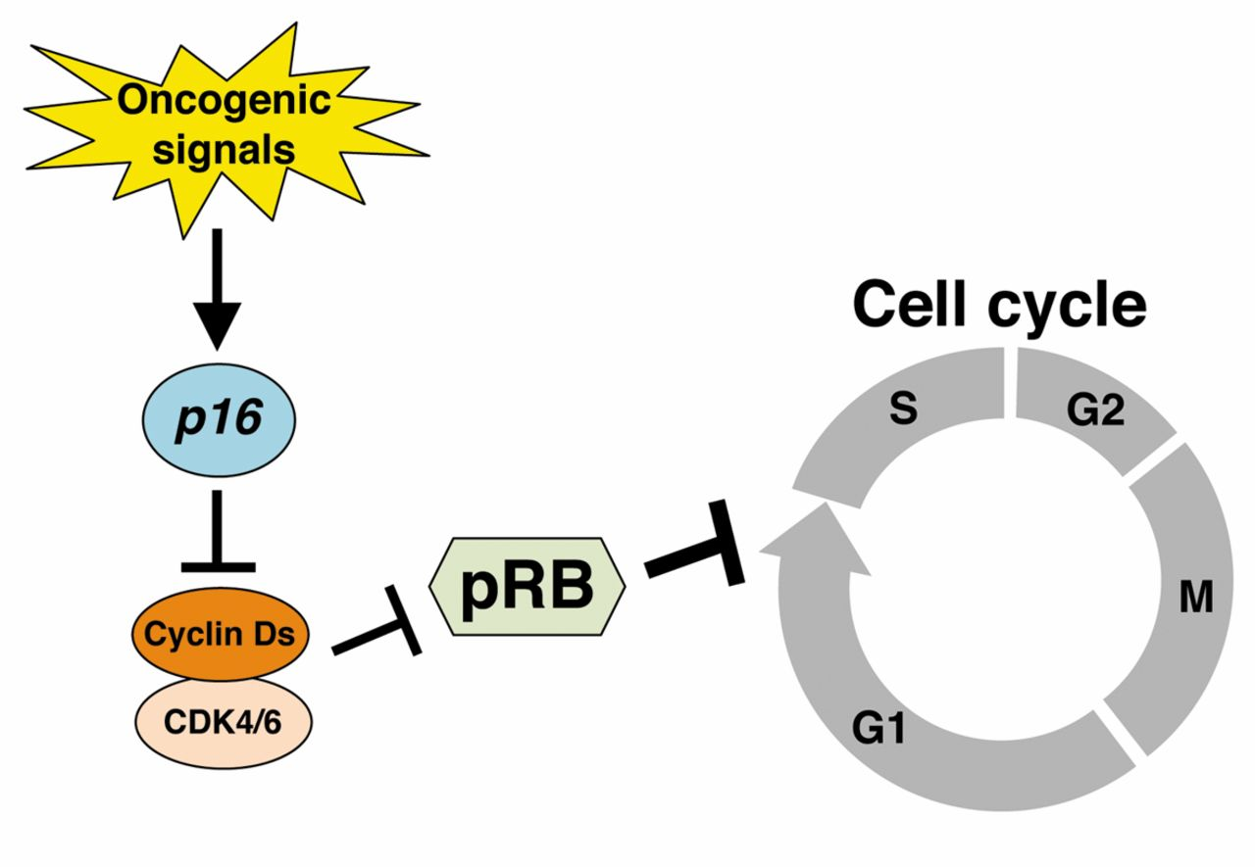
Background
CDKN2A (p16) most common gene mutation in hereditary melanoma
70% lifetime risk of melanoma
15-20% lifetime risk of PDAC
“p16-Leiden” founder mutation in in The Netherlands
Pancreatic surveillance for CDKN2A since 2000 in LUMC
Notes:
Incidence is increasing; expected to be the 2nd cause of cancer related mortality in 2030

Slide 14
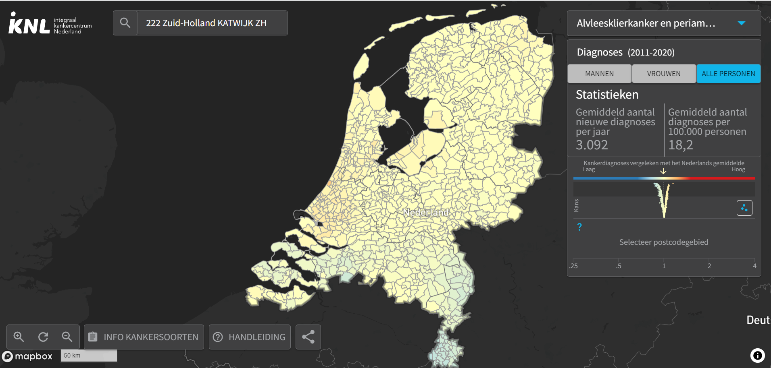
Nederlandse Kankeratlas

Slide 15
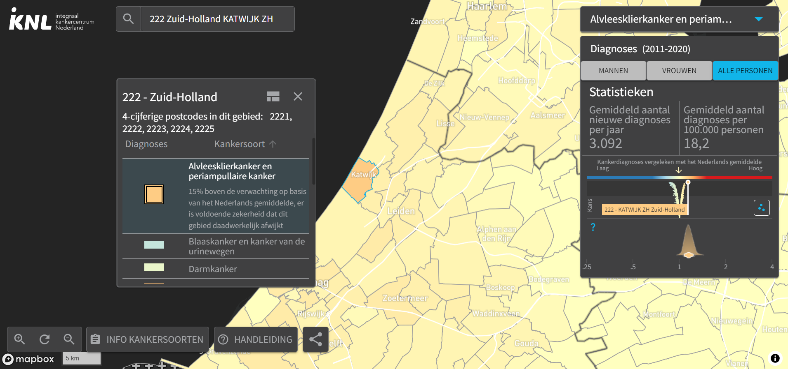

Slide 16
Evaluation of the yield and outcomes of 20-years pancreatic surveillance in a large cohort of germline CDKN2A/p16 mutation carriers
Notes:
Incidence is increasing; expected to be the 2nd cause of cancer related mortality in 2030

Slide 17
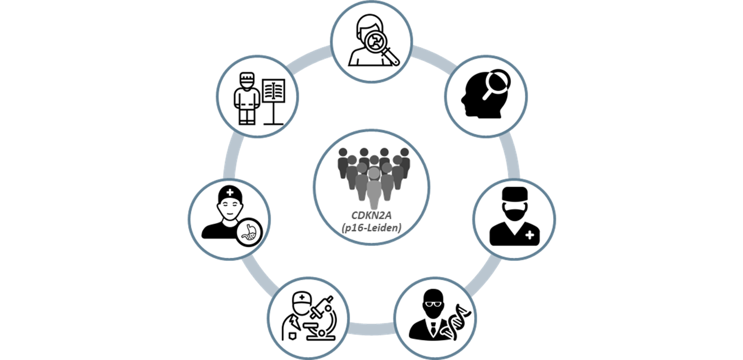
Methods – surveillance
Dedicated multidisciplinary team
Carriers of a proven germline CDKN2A/p16 mutation
Starting age ≥45 years*
MRI/MRCP every 12 months, EUS optional
New/indeterminate lesions
→ interval 3-6 months or EUS-guided sampling
Notes:
Incidence is increasing; expected to be the 2nd cause of cancer related mortality in 2030

Slide 18



Methods – outcomes
Number and nature of pancreatic lesions
Cumulative incidence of PDAC
Outcomes of PDAC cases
Stage
Resection rate
Survival

Slide 19
STUDY POPULATION
347 carriers of a germline CDKN2A PV - 99% “p16-Leiden”
58% female
Age at enrollment: 49 (44.5 – 55.7) years
38% at least one FDR with PDAC
55% a personal history of melanoma
Median follow-up of 5.6 (2.3 – 9.9) years
In total 2098 MRI and 208 EUS performed

Slide 20
36 cases of pdac in 31 individuals
36 PDAC in 31 (9%) patients
5 (16.1%) second PDAC
9 (3%) patients no PDAC
1
Synchronous
7
Benign/LGD
4
Metachronous
1
St I ampullary ca
Median age: 60 (51 – 64) years
65% female
1
Grade 1 NET
Notes:
Incidence is increasing; expected to be the 2nd cause of cancer related mortality in 2030

Slide 21
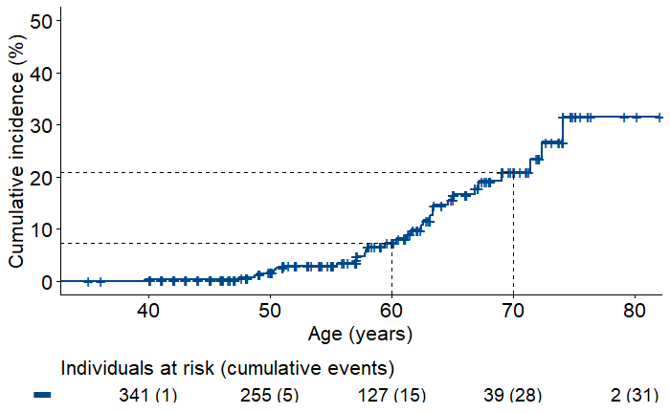
High lifetime risk of pdac
Cumulative incidence of 21% at age 70
21%
7%

Slide 22
Summary of cases
8 (22%) at first screening
28 (78%) during follow-up
6 (17%) interval cancer
29 (81%) MRI/MRCP
1 (3%) EUS
44% head - 56% body/tail

Slide 23
Summary of cases
8 (22%) at first screening
28 (78%) during follow-up
6 (17%) interval cancer
29 (81%) MRI/MRCP
1 (3%) EUS
44% head - 56% body/tail

Slide 24
Stage and resectability
83% Resectable
75% (27/36) surgery
74% (20/27) R0 resection

Slide 25
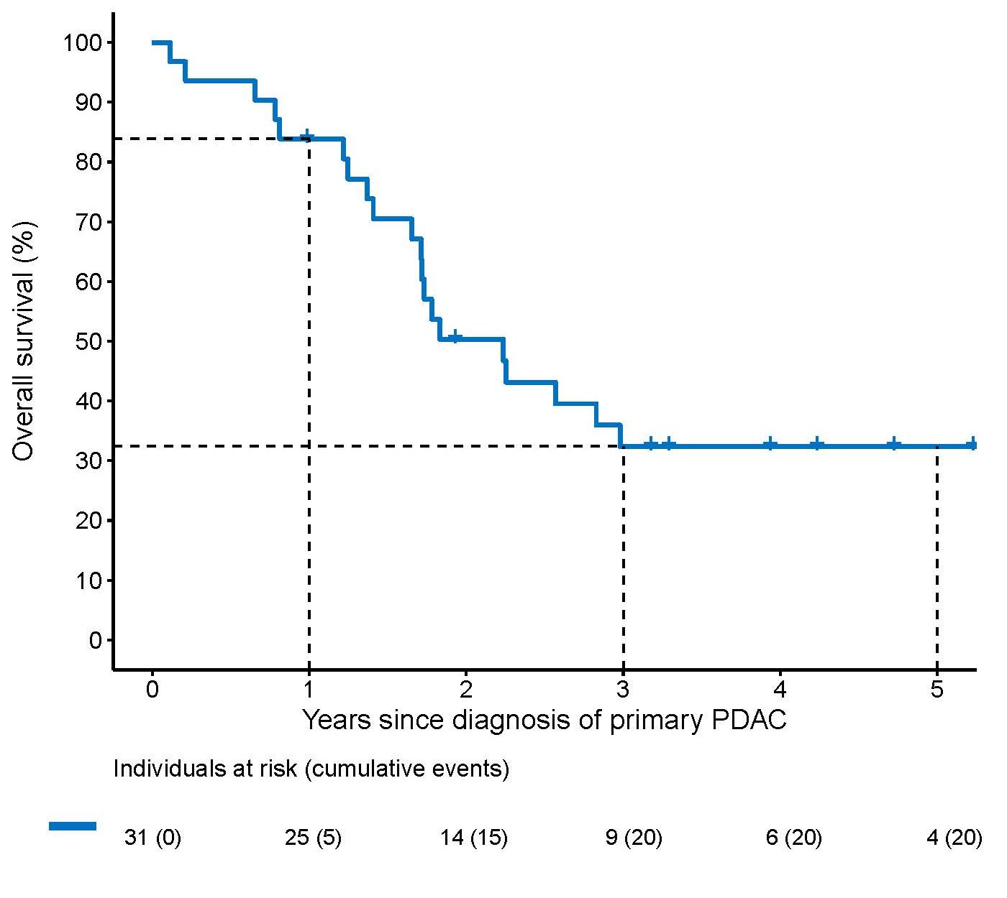
Survival after primary pdac
Median survival = 27 months
32%

Slide 26
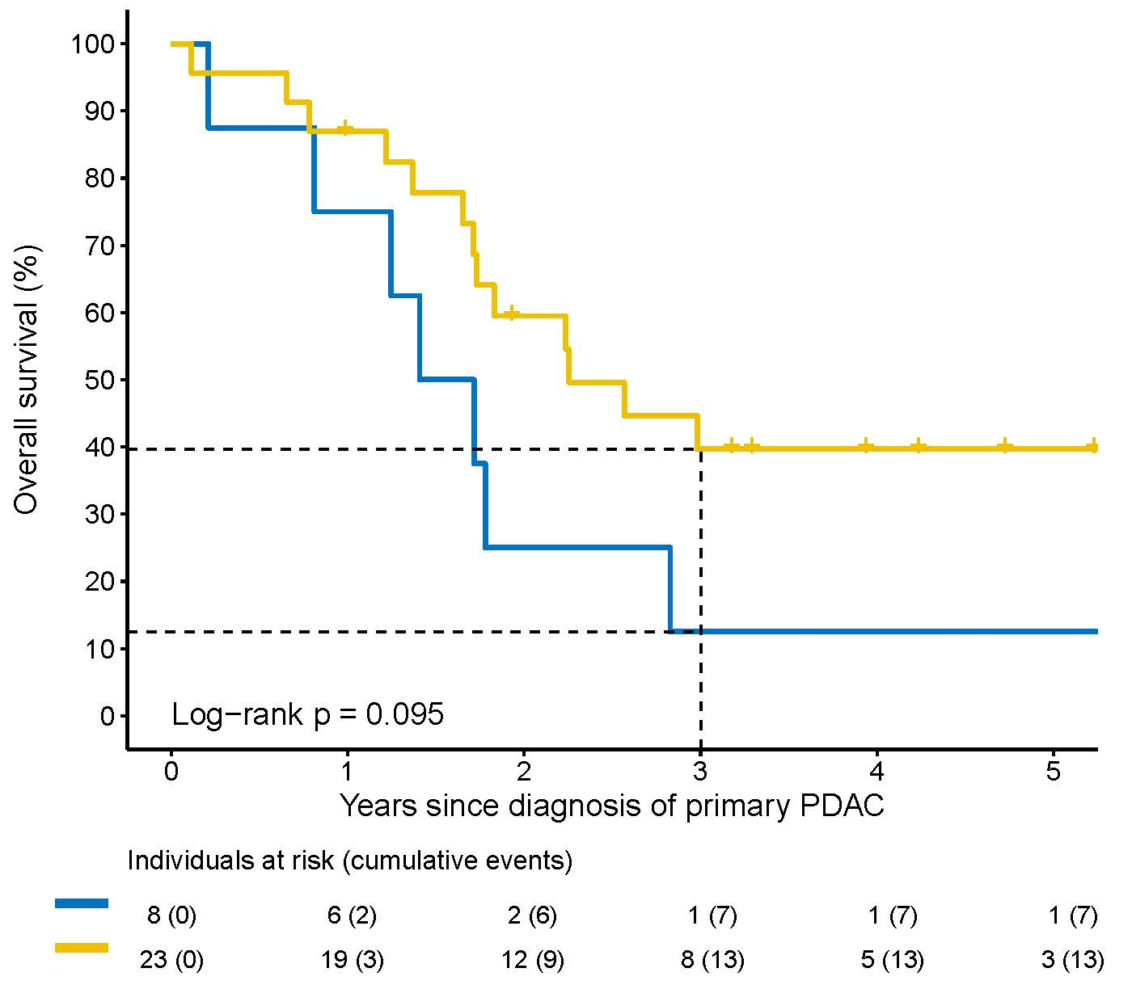
Survival after primary pdac
Median survival = 27 months
n=23
2011 – 2021
n=8
2000 – 2010
40%
32%
13%

Slide 27




Key takeaways Surveillance for PDAC in CDKN2A Mutation Carriers
High lifetime risk of (second) PDAC
33% diagnosed with stage I PDAC
More than 80% resectable
5-year survival of 32%

Slide 28
discussion and feature directions
7/45 (16%) “false-positive” surgery
In contrast: Canto et al. 2020: 50% (24/48) low-grade precursor lesion
→ Evaluation of surgical outcomes, short- and long-term morbidity
High-risk of second PDAC
→ Evaluation of clonal relatedness
Total pancreatectomy for cT1N0 PDAC?
Risk stratification (family history, modifiable risk factors) within surveillance cohort
Biomarkers

Slide 29


Thank you for your attention!
Derk Klatte
d.c.f.Klatte@lumc.nl

Slide 30
Are the outcomes in our surveillance program indeed better?
Ideal situation: compare outcomes with p16 mutation carriers not in surveillance
No control groups available
RCTs unethical
Alternative: compare outcomes with control group from general population
Stage
Resectability
Survival adjusted for lead time

Slide 31
Methods - study population
All patients with PDAC between 2000 – 2020 from Netherlands Cancer Registry (NCR)
Within NCR → primary PDAC in LUMC surveillance program
Propensity score matched cohort
Surveillance patients 1:5 with “non-surveillance” patients
Age
Sex
Year of diagnosis
Tumor location (head vs. body/tail)

Slide 32
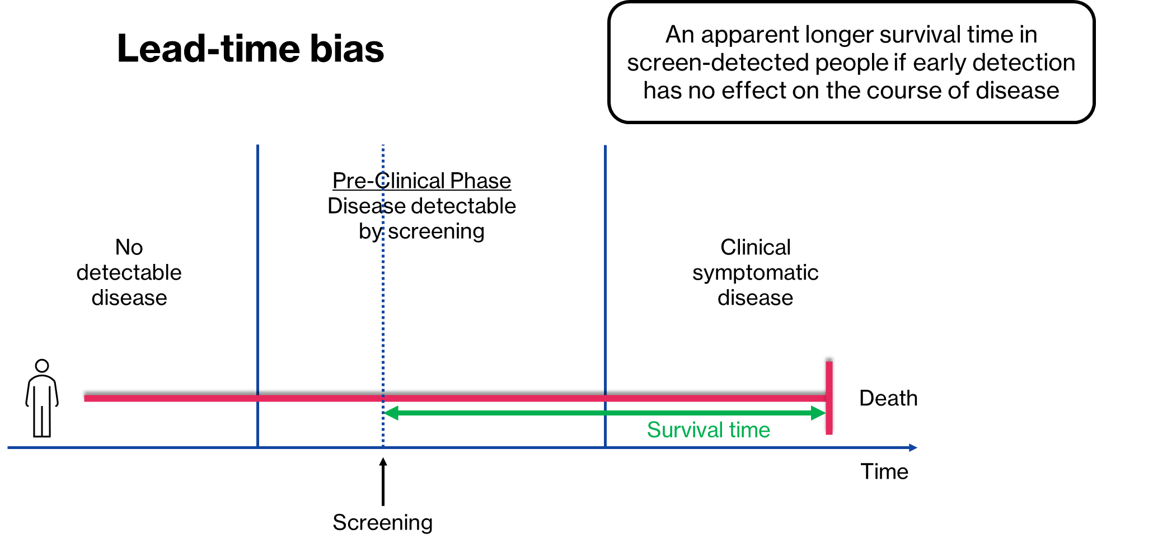
Adjustment for lead time

Slide 33
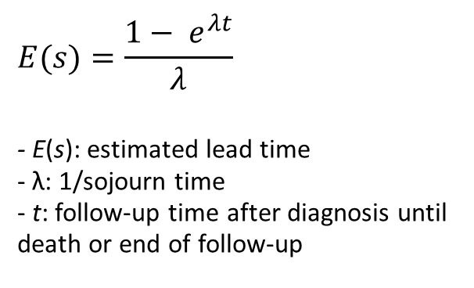
Adjustment for lead time
Estimation of additional follow-up time purely as a result of lead time in screen-detected cancers
No previous literature available on sojourn times (asymptomatic, but-screen detectable)
Progression from stage I → IV average of 15 months
Assumptions of sojourn times: 3, 6, 12, and 15 months
$$E(s)=\frac{1− e^{λt}}{λ}$$
- E(s): estimated lead time - λ: 1/sojourn time - t: follow-up time after diagnosis until death or end of follow-up
Estimated lead-times subtracted from screen-detected cases
Duffy et al. Am J Epidemiol 2008

Slide 34
Patient characteristics
 | Unmatched cohorts |  |  |  | Matched cohorts
Patient characteristics | Non-surveillance (n=43 731) | Surveillance (n=31) | SMD |  | Non-surveillance (n=155) | Surveillance (n=31) | SMD
Age at diagnosis, median (IQR) | 71 (63 - 78) | 60 (53 - 64) | -1.4 |  | 60 (10.5) | 60 (9.0) | 0.0
<40 | 209 (0.5) | 1 (3.2) |  |  | 2 (1.3) | 1 (3.2)
40 - 49 | 1509 (3.5) | 4 (12.9) |  |  | 19 (12.3) | 4 (12.9)
50 - 59 | 5744 (13.1) | 10 (32.3) |  |  | 54 (34.8) | 10 (32.3)
60 - 69 | 11 973 (27.4) | 13 (41.9) |  |  | 65 (41.9) | 13 (41.9)
70 - 79 | 14 818 (33.9) | 3 (9.7) |  |  | 15 (9.7) | 3 (9.7)
≥80 | 9 478 (21.7) | 0 (0.0) |  |  | 0 (0.0 | 0 (0.0)
Male | 21 972 (50.2) | 11 (35.5) | 0.3 |  | 52 (33.5) | 11 (35.5) | 0.0
Year of diagnosis
2000 - 2005 | 9 125 (20.9) | 3 (9.7) | -0.4 |  | 16 (10.3) | 3 (9.7) | 0.0
2006 - 2010 | 9 628 (22.0) | 5 (16.1) | -0.2 |  | 24 (15.5) | 5 (16.1) | 0.0
2011 - 2015 | 11 366 (26.0) | 6 (19.4) | -0.2 |  | 26 (16.8) | 6 (19.4) | 0.0
2016 - 2020 | 13 612 (31.1) | 17 (54.8) | 0.5 |  | 89 (57.4) | 17 (54.8) | 0.0

Slide 35
Patient characteristics
 | Unmatched cohorts |  |  |  | Matched cohorts
Patient characteristics | Non-surveillance (n=43 731) | Surveillance (n=31) | SMD |  | Non-surveillance (n=155) | Surveillance (n=31) | SMD
Age at diagnosis, median (IQR) | 71 (63 - 78) | 60 (53 - 64) | -1.4 |  | 60 (10.5) | 60 (9.0) | 0.0
<40 | 209 (0.5) | 1 (3.2) |  |  | 2 (1.3) | 1 (3.2)
40 - 49 | 1509 (3.5) | 4 (12.9) |  |  | 19 (12.3) | 4 (12.9)
50 - 59 | 5744 (13.1) | 10 (32.3) |  |  | 54 (34.8) | 10 (32.3)
60 - 69 | 11 973 (27.4) | 13 (41.9) |  |  | 65 (41.9) | 13 (41.9)
70 - 79 | 14 818 (33.9) | 3 (9.7) |  |  | 15 (9.7) | 3 (9.7)
≥80 | 9 478 (21.7) | 0 (0.0) |  |  | 0 (0.0 | 0 (0.0)
Male | 21 972 (50.2) | 11 (35.5) | 0.3 |  | 52 (33.5) | 11 (35.5) | 0.0
Year of diagnosis
2000 - 2005 | 9 125 (20.9) | 3 (9.7) | -0.4 |  | 16 (10.3) | 3 (9.7) | 0.0
2006 - 2010 | 9 628 (22.0) | 5 (16.1) | -0.2 |  | 24 (15.5) | 5 (16.1) | 0.0
2011 - 2015 | 11 366 (26.0) | 6 (19.4) | -0.2 |  | 26 (16.8) | 6 (19.4) | 0.0
2016 - 2020 | 13 612 (31.1) | 17 (54.8) | 0.5 |  | 89 (57.4) | 17 (54.8) | 0.0

Slide 36
Tumor and treatment characteristics
 | Unmatched cohorts |  |  |  | Matched cohorts
 | Non-surveillance (n=43 731) | Surveillance (n=31) | SMD |  | Non-surveillance (n=155) | Surveillance (n=31) | SMD
Tumor location
Head | 26 586 (60.8) | 15 (48.4) | -0.2 |  | 75 (48.4) | 15 (48.4) | 0.0
Body/tail | 11 286 (25.8) | 13 (41.9) | 0.5 |  | 80 (51.6) | 16 (51.6) | 0.0
Other | 3 223 (7.4) | 3 (9.7) | -0.3 |  | 13 (8.4) | 0 (0.0) | 0.0
Unknown | 2 634 (6.0) | 0 (0.0) | -0.3 |  | 6 (3.9) | 0 (0.0) | 0.0
Surgical resection | 5 694 (13.0) | 22 (71.0) | - |  | 29 (18.7) | 22 (71.0) | -
Whipple/PPPD/PRPD | 4 556 (80.0) | 12 (54.5) |  |  | 19 (65.5) | 12 (54.5)
Distal pancreatectomy | 665 (11.7) | 9 (40.9) |  |  | 8 (27.6) | 9 (40.9)
Total pancreatectomy | 92 (1.6) | 0 (0.0) |  |  | 0 (0.0) | 0 (0.0)
Other type or unspecified | 381 (6.7) | 1 (4.5) |  |  | 2 (6.9) | 1 (4.5)
Neoadjuvant chemotherapy | 641 (1.5) | 3 (9.7) | - |  | 6 (3.9) | 3 (9.7) | -

Slide 37
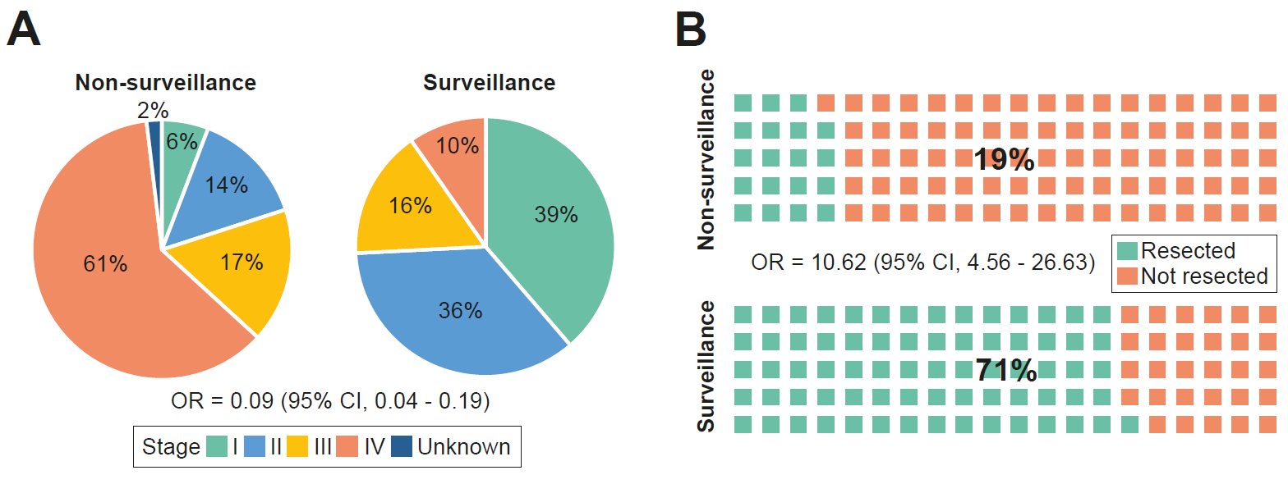
Lower stage and more often resectable

Slide 38
Lower stage and more often resectable

Slide 39
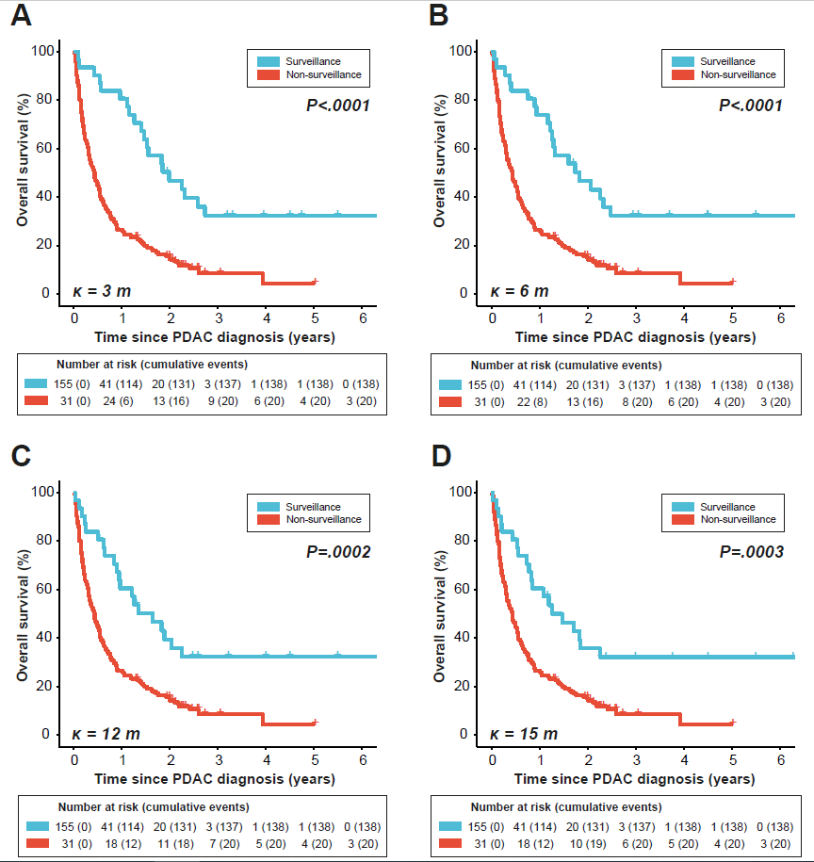
Lead-time adjusted survival
Median OS = 23.9 m
Mortality rates:
- Non-surveillance = 114.5/100 PY
- Surveillance = 21.9/100 PY
Unadjusted median OS in surveillance = 21.9 months
Median OS non-surveillance
= 5.2 months
Median OS = 15.2 m
32%

Slide 40
PDAC DIAGNOSED UNDER SURVEILLANCE as compared to pdac outside surveillance
Detected earlier with a lower stage
Increased resectability
Improved (lead-time adjusted) survival

Slide 41
Thank you for your attention!
Derk Klatte
d.c.f.Klatte@lumc.nl

Slide 42
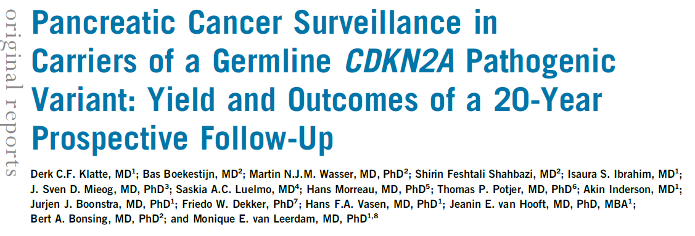

Klatte DCF et al. J Clin Oncol. 2022 Jun 3:JCO2200194. doi: 10.1200/JCO.22.00194. Epub ahead of print. PMID: 35658523.
Notes:
Incidence is increasing; expected to be the 2nd cause of cancer related mortality in 2030

